Slide 1
Presentation
Introduction: 2 min <Jen>
Exclude the year 2020 (skews analysis)
5 perceptions: 2-3 min per perception
ACC <Jen>
Big 10 <Matthew>
Big 12 <Monica>
Pac 12 <Josie>
SEC <Jody>
Does offense or defense win games? 1 min <Monica>
Conclusion

Slide 2
Fumbling through wins and losses
AN ANALYSIS ON COLLEGE FOOTBALL STATISTICS

Slide 3
THE KICKOFF
College football is the second most popular sport in the US
47.5M fans attended games & 145M unique fans watched 392 telecast games in 2019 (according to footballfoundation.org)
Data gathered from collegefootballdata.com
Focused on team statistics and total wins and losses for years 2017-2022
Mapped the raw data to identify offensive v. defensive statistics
Included mapping to define whether the statistic was a positive/good statistic (i.e. total yards) or a negative/bad statistic (i.e. total penalties)

Slide 4
THE FIRST DOWN
Historical popular perceptions of the power five conferences; do they stand true today?
ACC: A step down from the SEC
Big 10: A power conference, lots of defense, strong running game
Big 12: Spread offenses, doesn’t play a lot of defense
Pac 12: Spread offenses, smaller lineman, fast
SEC: Strong defense, low scoring games

Slide 5

Big 10 Conferences
AN ANALYSIS ON Big 10 FOOTBALL STATISTICS

Slide 6
Big 10 Perception and focus
Historical popular perceptions of the power five conferences; do they stand true today?
Big 10: A power conference, lots of defense, strong running game
In the analysis forward for the Big 10 conference, we would be concentrating only on the defense data
We plan to perform the following analysis to see how the teams are doing:
Analyze the data by plotting which Big 10 team has the highest average statistics value over the years from 2017-2021 with the exclusion of year 2020
Analyze which state would top the score among the Big 10.
Analyze the trend of the teams over the years individually for every possible year. This gives a glimpse of teams which are consistent and would help us to make a prediction further.

Slide 7
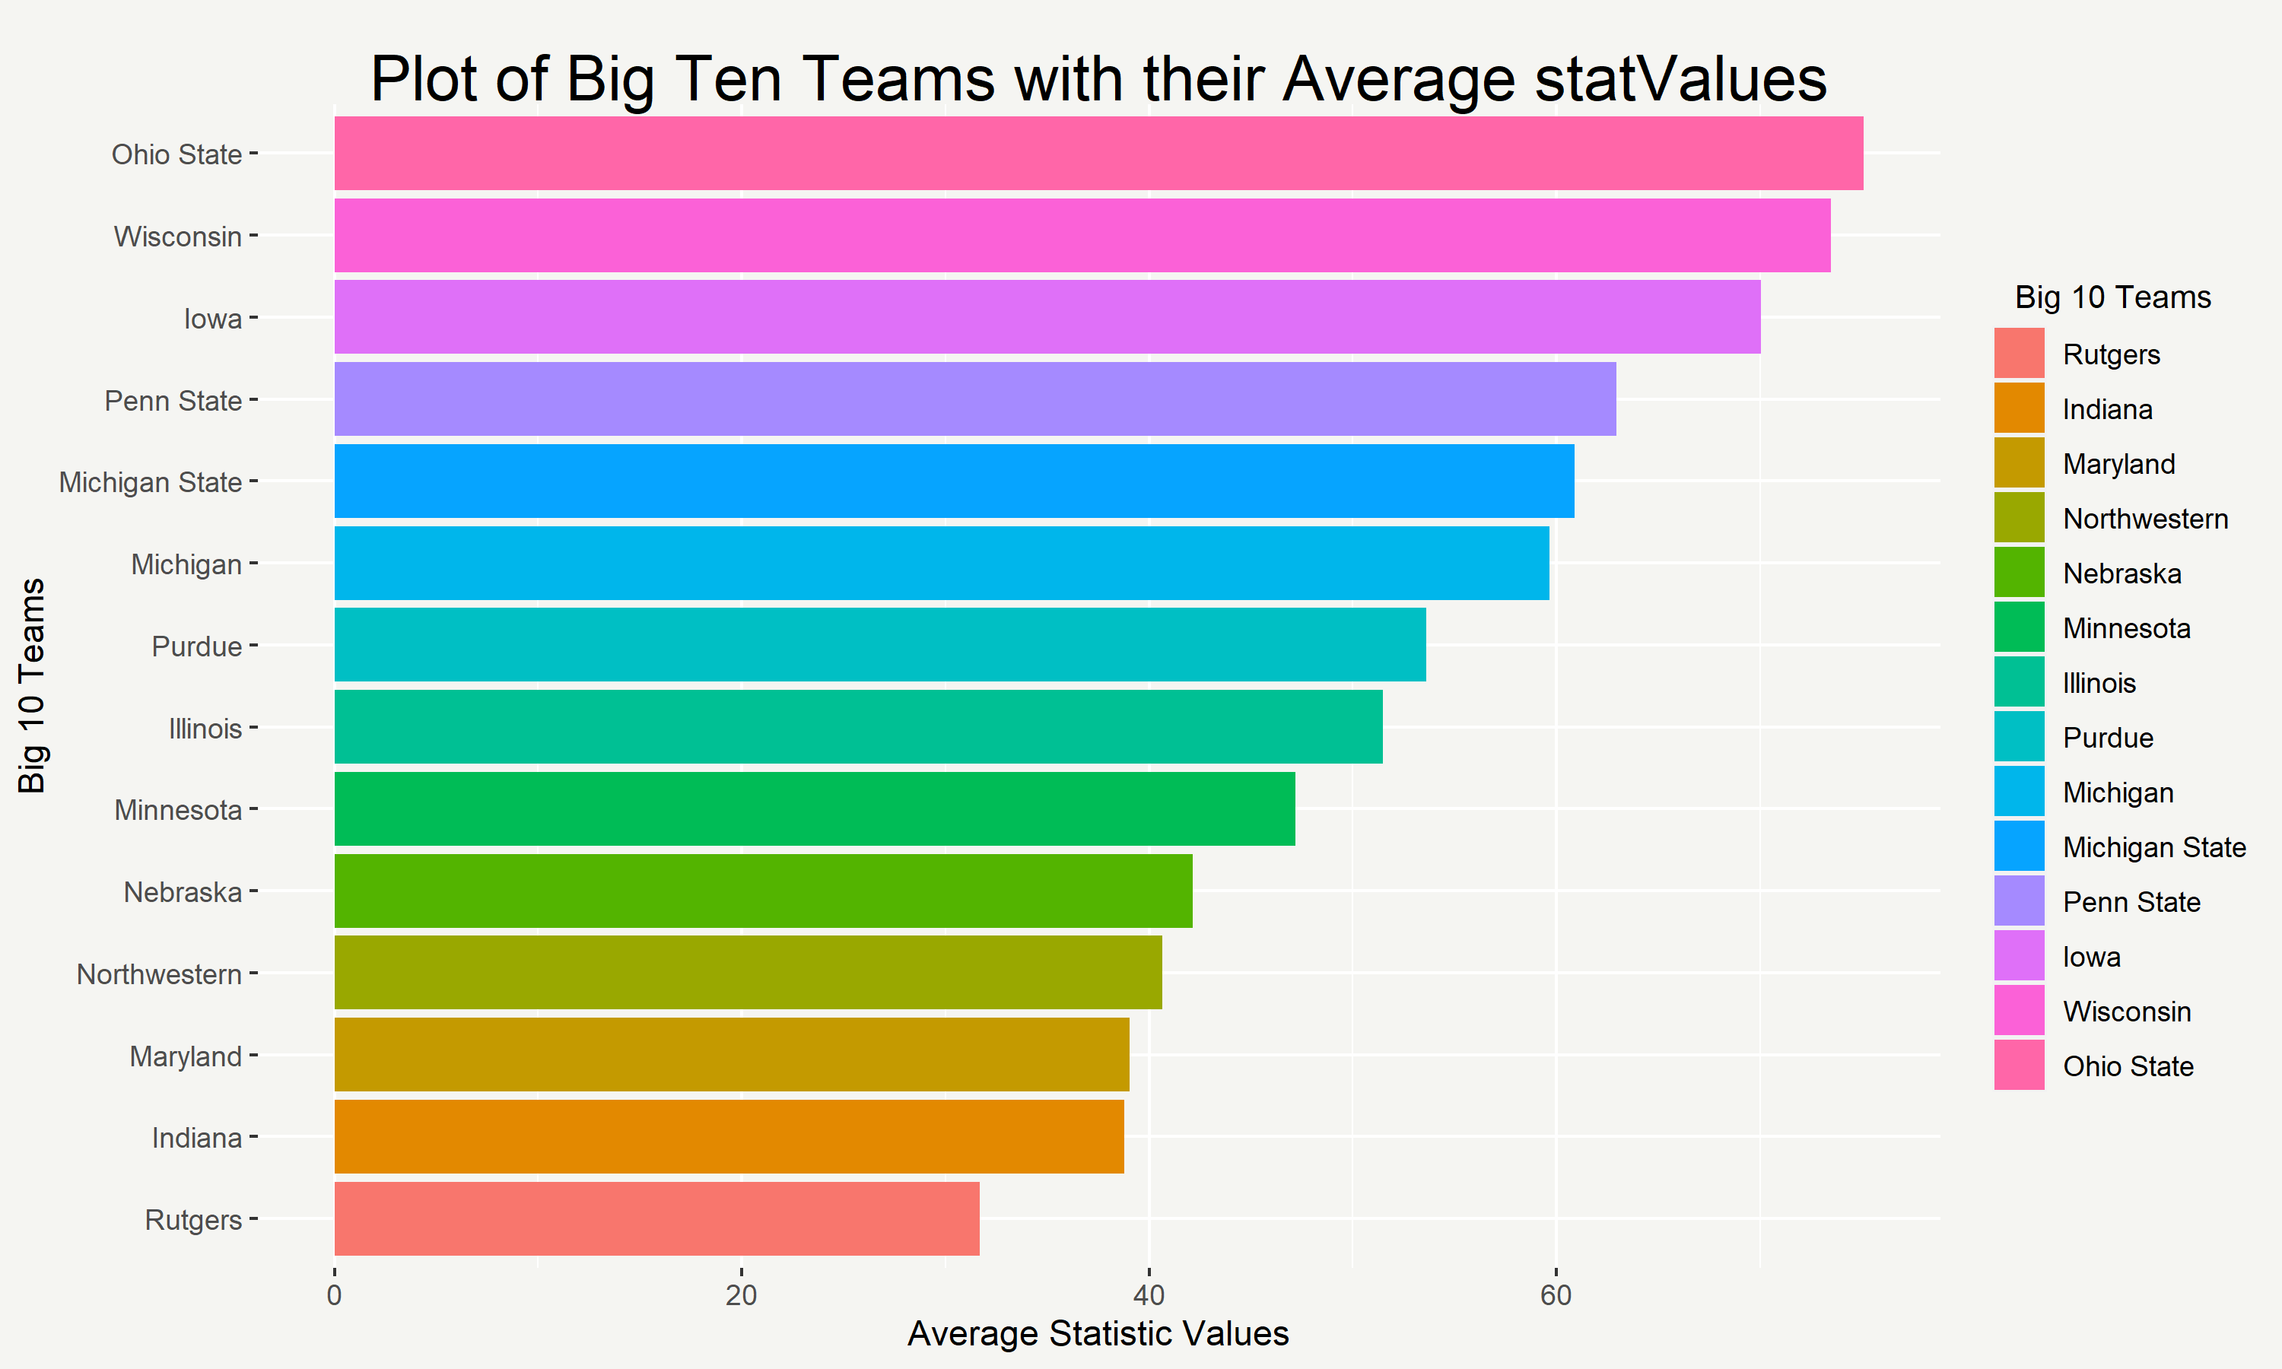
BIG 10 TEAMS WITH THEIR RATINGS
Plot of Big 10 teams with their average statistic over the period from 2017-2021 excluding year 2020
Ohio State team tops the chart with their average statistics

Slide 8
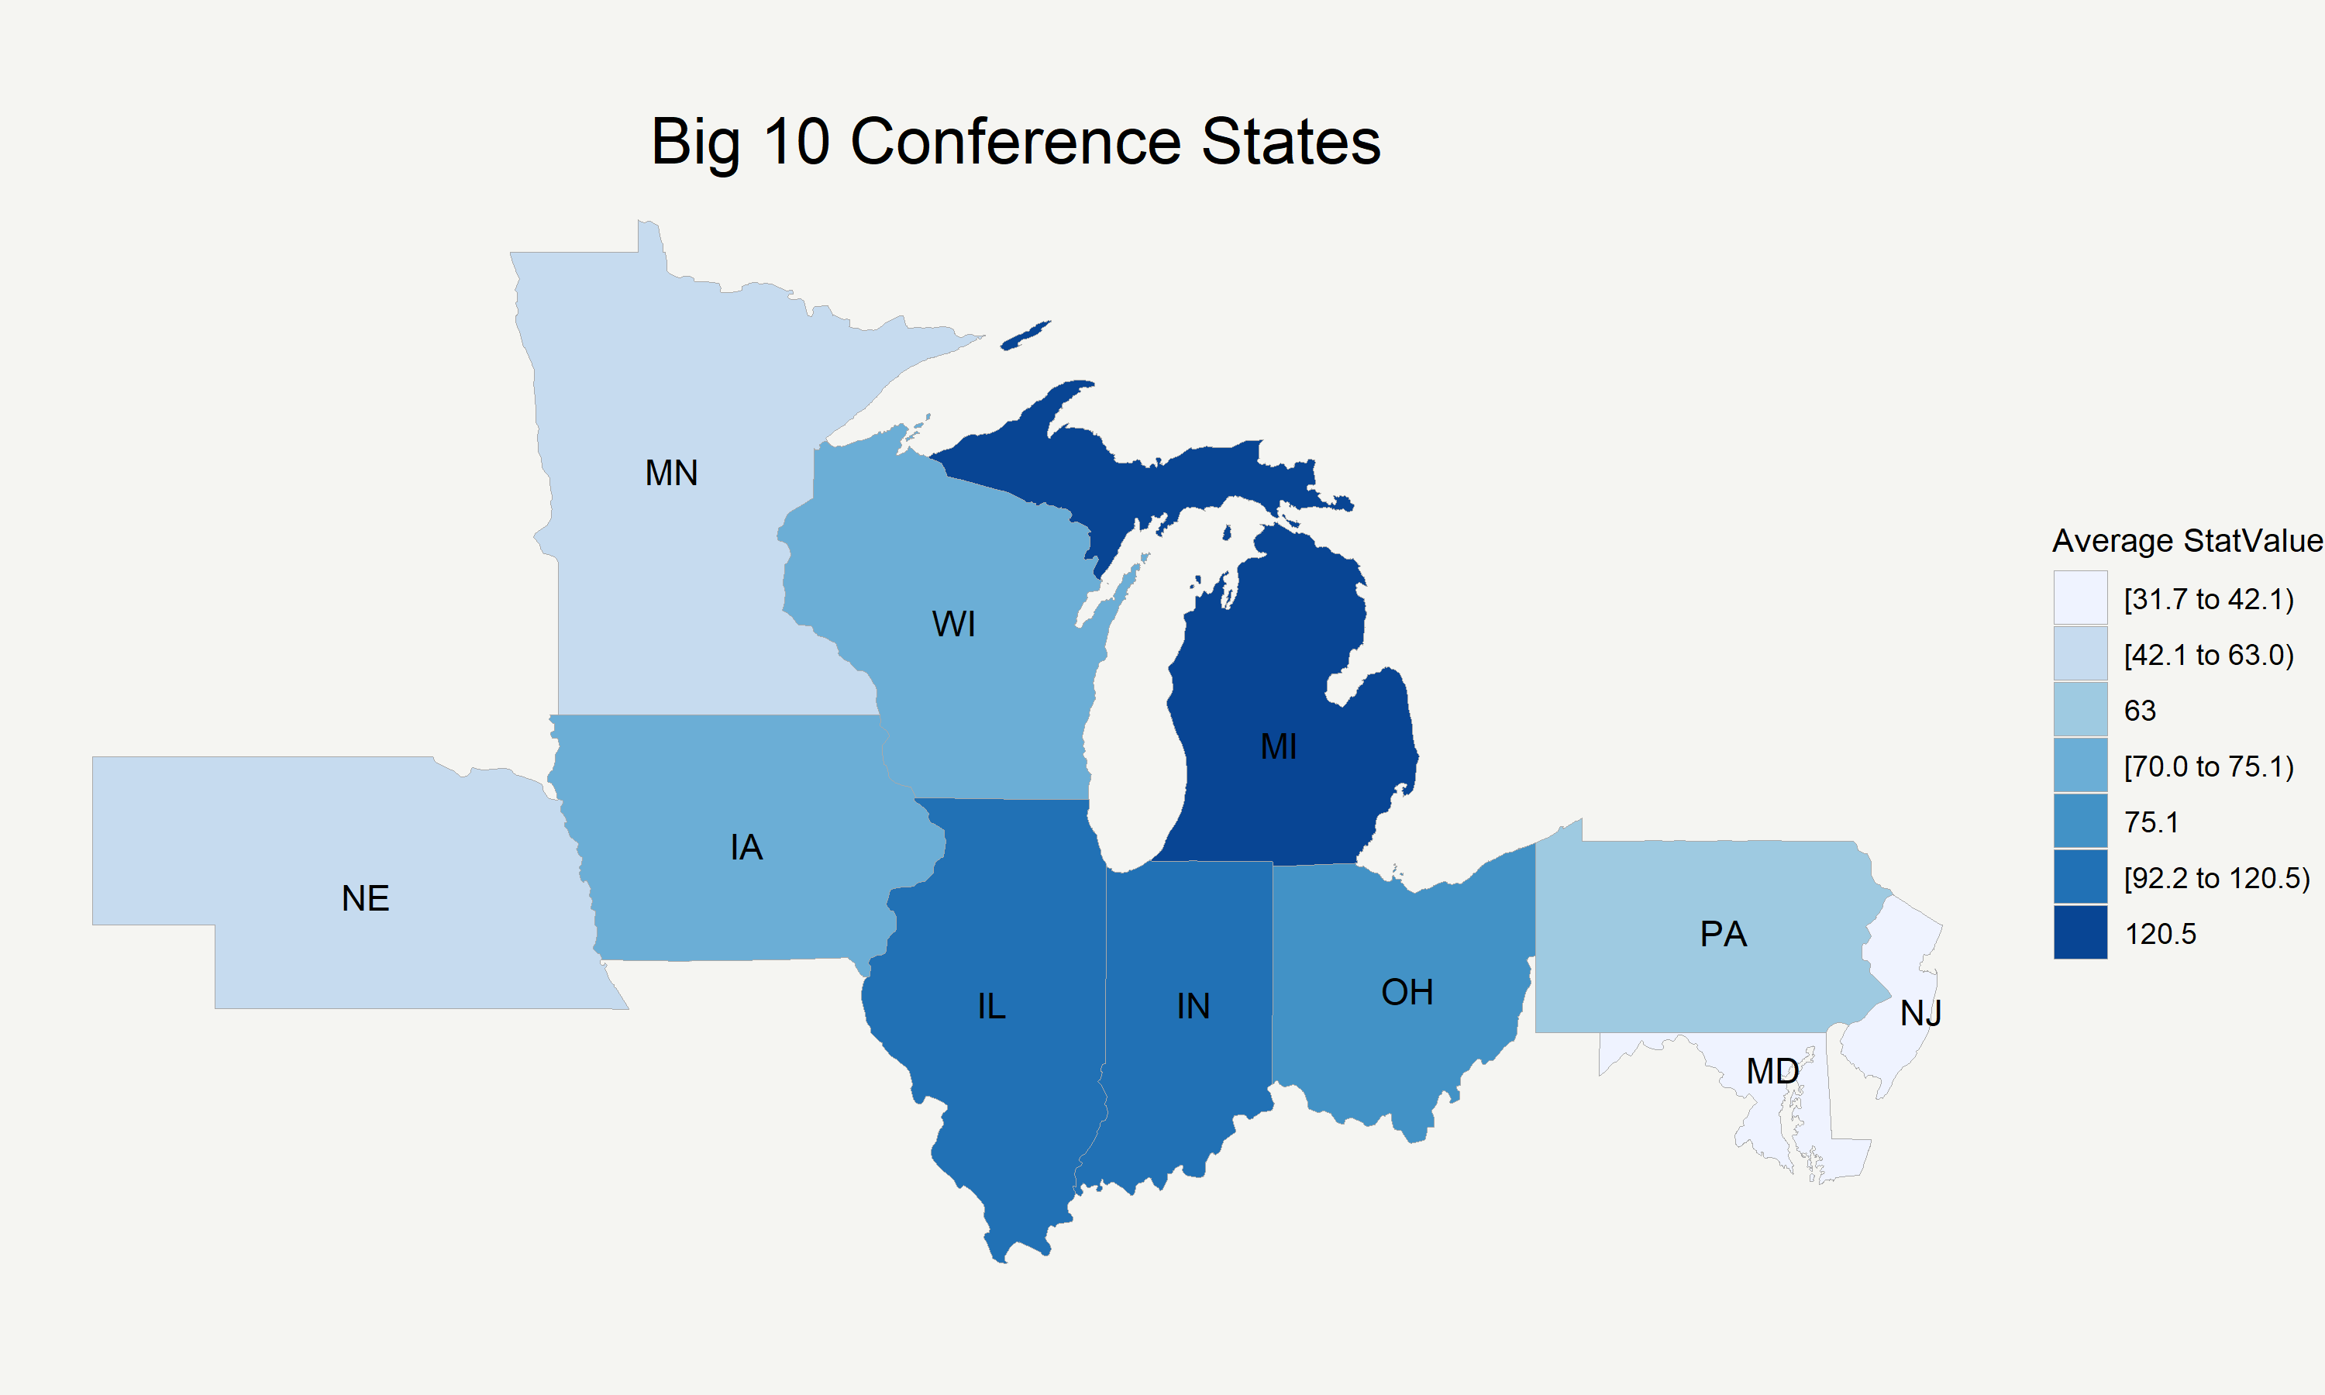

Slide 9
